Slide 1
Steganography
CAPSTONE PROJECT
Presented By:
Student Name : Ashvin Patel
College Name & Department : S.P.B patel engineering collage

Slide 2
OUTLINE
• Problem Statement
• Technology Used
• Wow Factors
• End Users
• Results
• Conclusion
• GitHub Link
• Future Scope

Slide 3
Problem Statement
Traditional encryption methods protect data but make it obvious that data is being transmitted.
Steganography hides data inside images, audio, or text, making it undetectable.
This project implements an image-based steganography tool to securely transmit confidential messages without raising suspicion.

Slide 4
Technology Used
• Programming Language: Python
• Libraries Used: OpenCV, NumPy, LSB Steganography Library
• Platform: Windows/Linux

Slide 5
Wow Factors
• Invisible Communication: Hides data inside images without altering their visual quality.
• Encryption Layer: Encrypts the message before embedding for extra security.
• User-Friendly GUI: Simple interface for encoding and decoding messages.
• Multi-Format Support: Works with PNG, BMP, and JPEG formats.
• Efficient Retrieval: Extracts hidden data without significant data loss.

Slide 6
End Users
• Journalists & Whistleblowers: Secure communication without attracting attention.
• Military & Government Agencies: Confidential message transmission.
• Cybersecurity Enthusiasts: Learning about secure data hiding techniques.
• General Users: Privacy-conscious individuals for personal security.

Slide 7
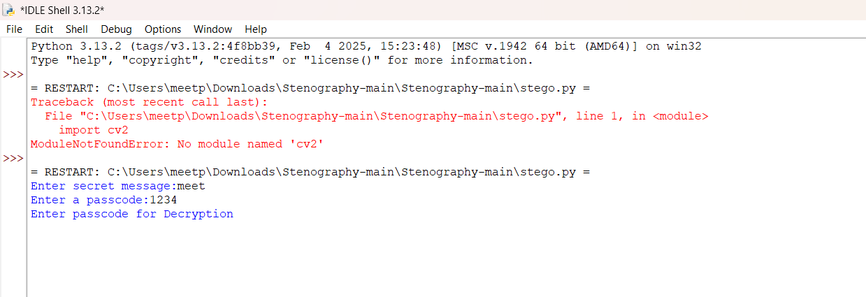
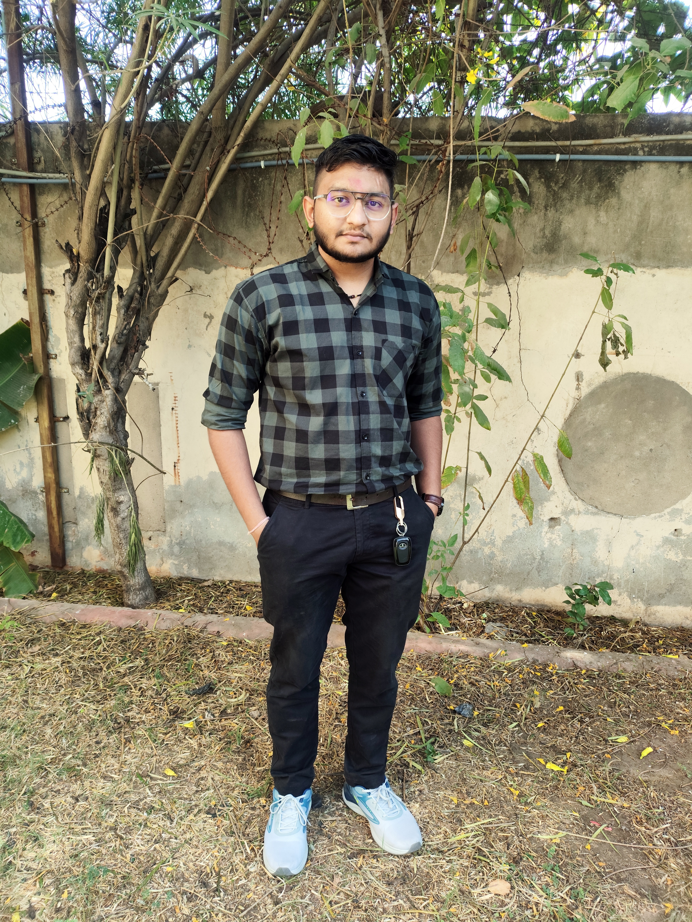
Results

Slide 8
Conclusion
This steganography project successfully demonstrates how sensitive data can be hidden inside images securely.
By combining cryptographic techniques with steganography, the system ensures enhanced security while maintaining secrecy.

Slide 9
GitHub Link
https://github.com/Ashvin1125/Steganography-Hide-data-in-image.git

Slide 10
Future Scope
• Implement audio and video steganography.
• Use deep learning for automatic detection and prevention of steganalysis.
• Improve efficiency with real-time encoding and decoding.
• Develop a mobile application for on-the-go secure messaging.

Slide 11
THANK YOU

